Slide 1
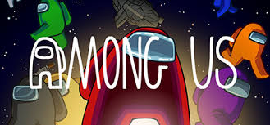
CM4125 Topic 3 Lab
i

Slide 2
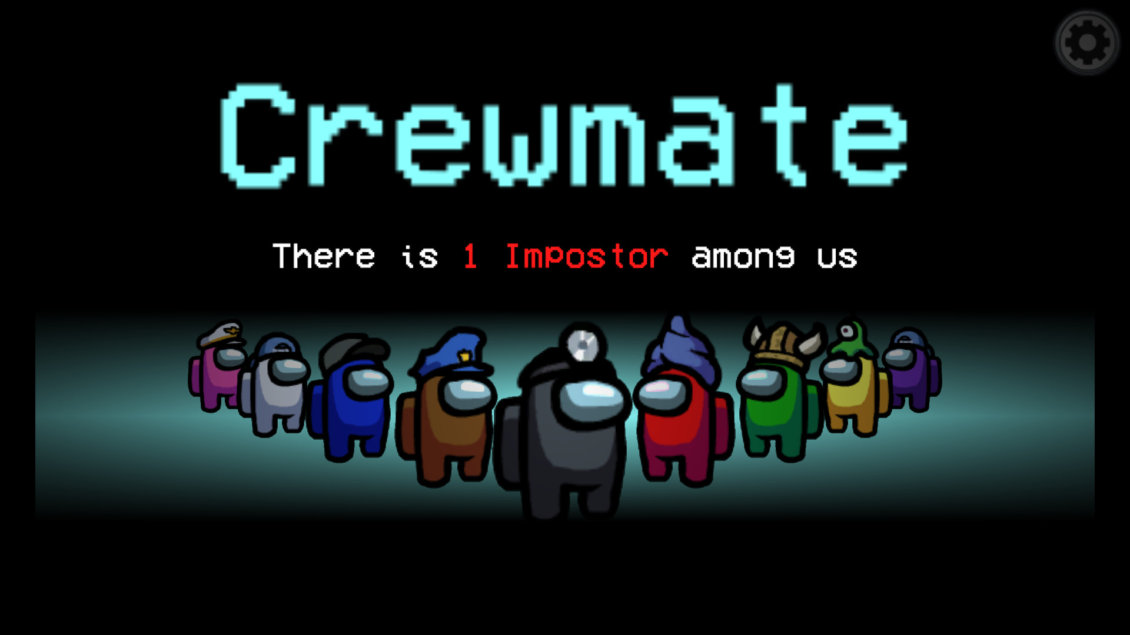
Setting
6 players
3 crewmates
3 impostors
Admin (me)
Assign roles
Keep time
Provide visualisations
“Kill” players
Keep track of crew’s suggestions
The rest will be public/voters

Slide 3
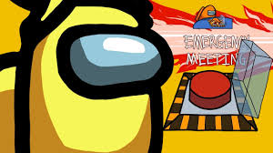
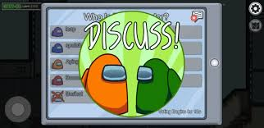
Rules
The admin will provide a “bad” visualisation to everyone
All players (and the public!) have ~5 minutes to see it and think about how to “improve” the visualisation
Crewmates want to make it better!
Impostors want to (secretly) make it worse!
Each player will give the admin one suggestion
Once all suggestions have been given to the admin, an emergency meeting is called!
Players have ~5 minutes to debate in public who the impostor is/are
After that, the public votes for someone to be sent off
The person with the most votes gets “killed” (out of the game)
Afterwards, a new visualisation will be provided, and the process starts again.

Slide 4
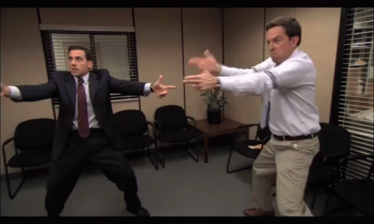
Consider that…
You must be actively participating during the emergency meeting
Play your strategy right and try to guess who is in your team
If you feel we have reached a dead end with an example, the admin can provide a new one
Notes:
-If everyone is voting for each other and things are tied, end the game and the team with most members alive wins

Slide 5
Let’s play!
https://www.matillion.com/wp-content/uploads/2015/01/bad-dashboard-examples-1.png
https://www.matillion.com/wp-content/uploads/2015/01/bad-dashboard-examples-3.png
https://luiscarli.com/2012/09/01/wood-changes/
https://carmel.es/wp-content/uploads/2018/10/ctf_1a_cio-dashboards.png
https://i.ytimg.com/vi/SNf2VJjTmd4/maxresdefault.jpg
https://cdn-wordpress-info.futurelearn.com/wp-content/uploads/37e0c522-1345-47e6-9a29-0030ff18fd6a-754x451.jpg.webp
https://miro.medium.com/v2/resize:fit:4800/format:webp/1*bnfoU2LkEnXJP0vjll47Lg.png
Notes:
Impostors: You want to focus more on the aesthetics rather than correcting the real problems of the visualisations. You want to divert the group’s attention to discuss things that are right rather than the ones that need to be addressed. You can pretend you are giving good suggestions in the beginning, but at some point, you have to sabotage it!

